Slide 1
Chapter 2 (Non Leaf Procedure)

Slide 2
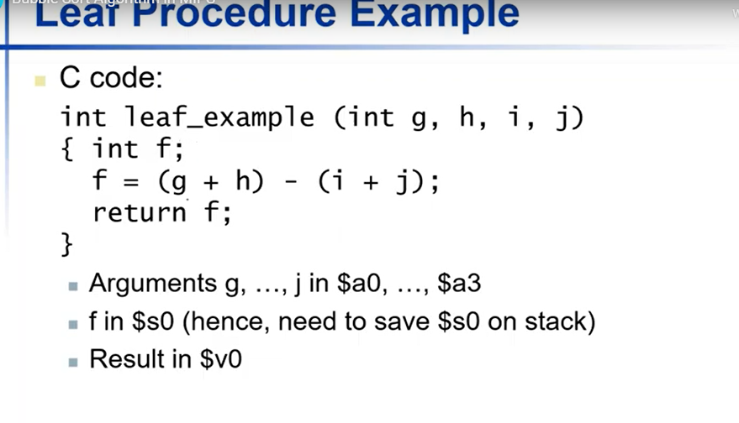

Slide 3
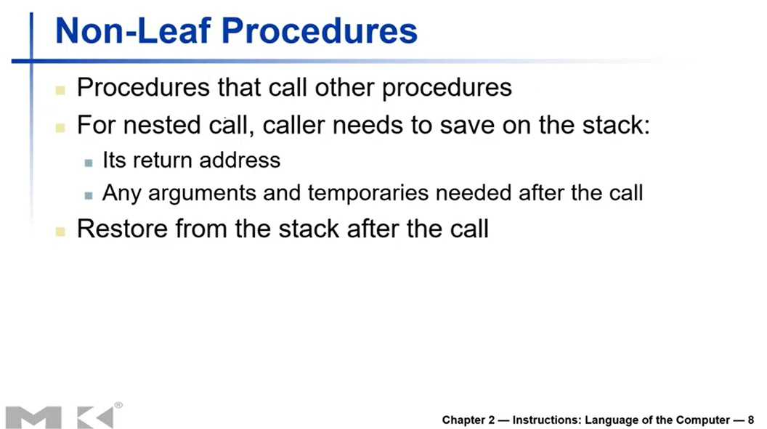

Slide 4
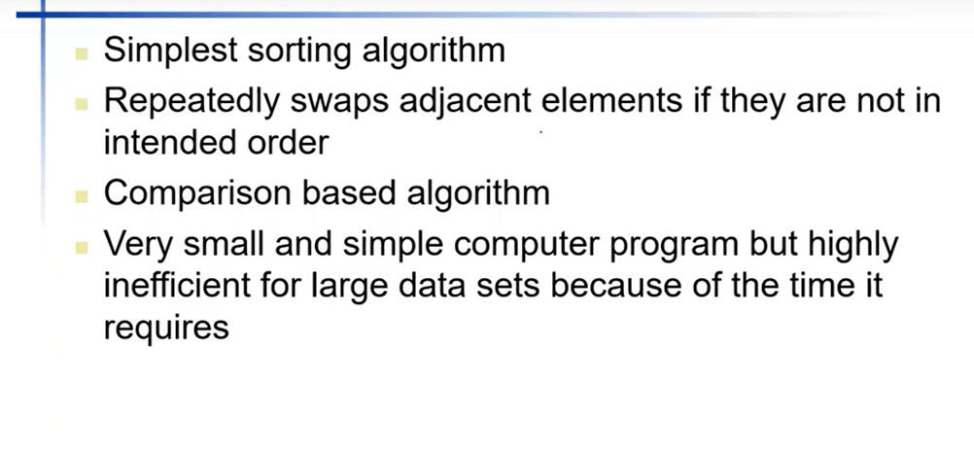
Bubble Sort

Slide 5
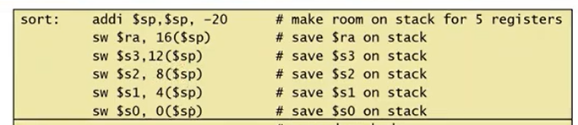
Bubble Sort
(base address) v in $a0,
n in $a1,
i in $s0
j in $s1
void sort(int v[], int n){
int i, j;
for(int i=0; i<n; i++){
for( j= i-1; j>=0 && v[j] > v[j+1]; j--){
swap(v,j);
}
}
void swap(int v[], int k){
int temp;
temp = v[k];
v[k]=v[k+1]
v[k+1] = temp;
}

Slide 6
add $s2, $a0, $zero
To store the values of parameters, $s2 = v, $s3 = n
Bubble Sort
add $s3, $a1, $zero
(base address) v in $a0,
n in $a1,
i in $s0
j in $s1
add $s0, $zero, $zero
i = 0
Loop 1:
slt $t0, $s0, $s3
i>n, $t=0 (loop exit)
void sort(int v[], int n){
int i, j;
for(int i=0; i<n; i++){
for( j= i-1; j>=0 && v[j] > v[j+1]; j--){
swap(v,j);
}
}
beq $t0, $zero, Loop1Exit
addi $s1, $s0, -1
j = i-1
Loop 2:
j<0, $t0 = 1
slti $t0, $s1, 0
bne $t0, $zero, Loop2Exit
sll $t1, $s1, 2
$t1=4*j
add $t2, $s2, $t1
$t2=4*j + base address of v[]
lw $t3, 0($t2)
$t3=v[j]
void swap(int v[], int k){
int temp;
temp = v[k];
v[k]=v[k+1]
v[k+1] = temp;
}
Swap:
lw $t4, 4($t2)
$t4=v[j+1]
sll $t1, $a1, 2
add $t1, $a0, $t1
lw $t0, 0($t1)
slt $t0, $t4, $t3
v[j+1]>v[j], $t0 = 0
beq $t0, $zero, Loop2Exit
lw $t2, 4($t1)
sw $t2, 0($t1)
sw $t0, 4($t1)
jr $ra
add $a0, $s2, $zero
add $a1, $s1, $zero
Loop2Exit:
(base address) v in $a0,
k in $a1,
Temp in $t0
jal swap
addi $s0, $s0, 1
addi $s1, $s1, -1
j Loop1
j Loop2

Slide 7
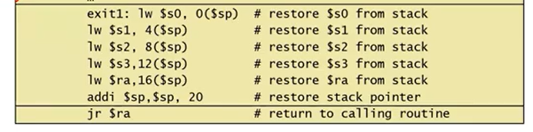
Bubble Sort
(base address) v in $a0,
n in $a1,
i in $s0
j in $s1
void sort(int v[], int n){
int i, j;
for(int i=0; i<n; i++){
for( j= i-1; j>=0 && v[j] > v[j+1]; j--){
swap(v,j);
}
}
void swap(int v[], int k){
int temp;
temp = v[k];
v[k]=v[k+1]
v[k+1] = temp;
}

